Slide 1
Python Operators

Slide 2
Python Operators
Operators are special symbols in Python that carry out arithmetic or logical computation.
The value that the operator operates on is called the operand.
For example:
>>> 2+3
5
Here, + is the operator that performs addition.
2 and 3 are the operands and 5 is the output of the operation.

Slide 3
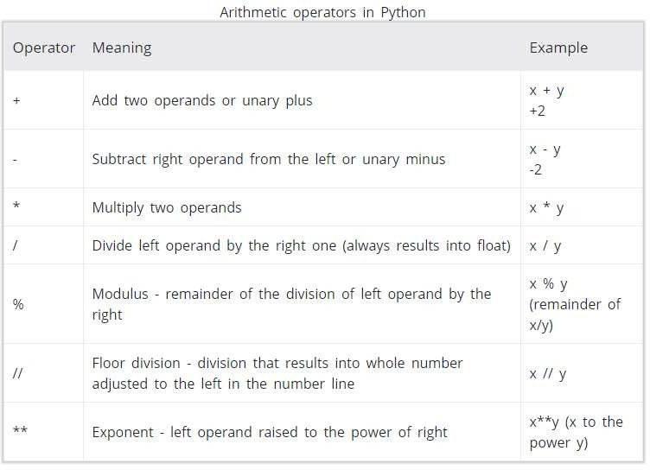
Arithmetic operators

Slide 4
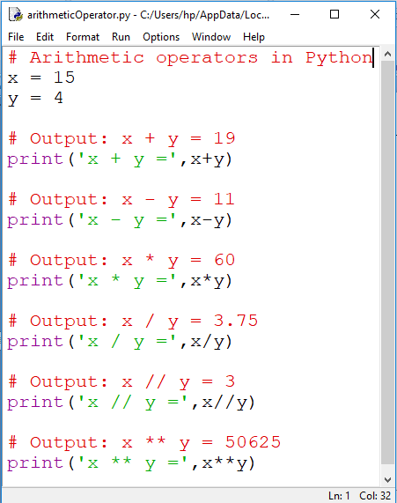
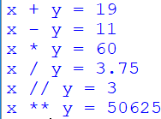
Example

Slide 5
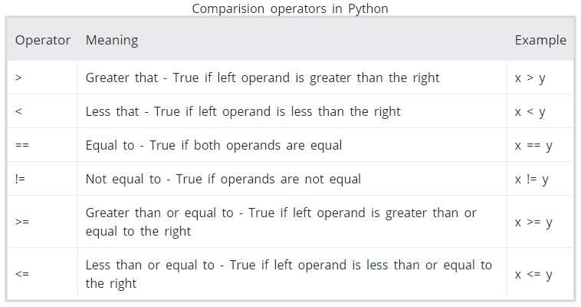
Comparison operators

Slide 6
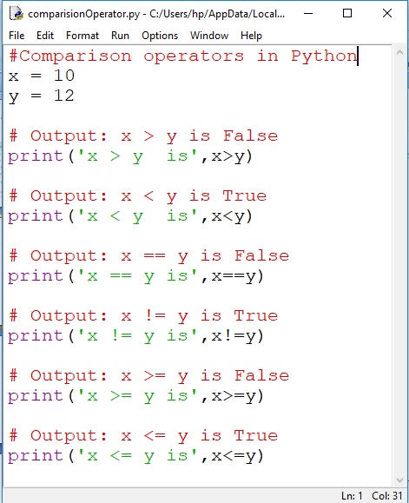
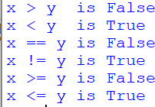

Slide 7
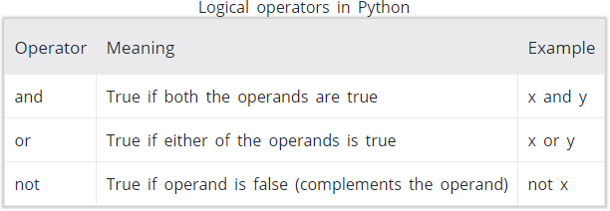
Logical operators

Slide 8
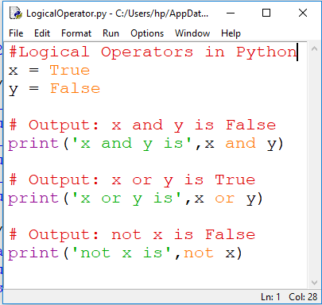


Slide 9
Operator Precedence and Associativity
The operator precedence determines the order in which the python interpreter evaluates the operators in an expression.
Where as associativity property decides which operation to be performed first.
Associativity is of two types.
a) Left to Right
Example: 4 + 6 – 3 + 2 = 9
b) Right to Left
X = Y = Z = Value
Note:
When the operators of same priority are found in the expression, precedence is given to the left most operator.

Slide 10
Associativity Continued….
Example:
Z = 4 * 6 + 8 // 2
= 28
In the above expression * is evaluated first, even though * and // have the same priorities. The operator * occurs before // and hence the evaluation starts from left to right.
Asociativity table for Arithmetic Operators
Precedence | Operators | Associativity
Highest Lowest | () | Innermost to Outermost
 | ** | Highest
 | *,/,//,% | Left to Right
 | + - | Left to Right

Slide 11
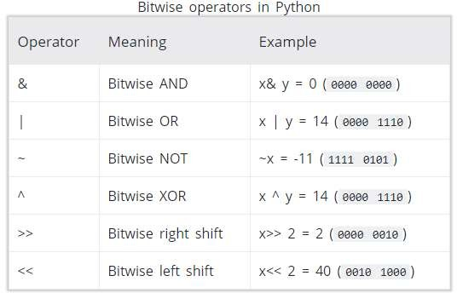
Bitwise operators
Bitwise operators act on operands as if they were string of binary digits. It operates bit by bit, hence the name.
In the table below: Let x = 10 (0000 1010 in binary) and y = 4 (0000 0100 in binary)

Slide 12
Assignment operators
Assignment operators are used in Python to assign values to variables.
a = 5 is a simple assignment operator that assigns the value 5 on the right to the variable a on the left.
There are various compound operators in Python like a += 5 that adds to the variable and later assigns the same.
It is equivalent to a = a + 5.

Slide 13
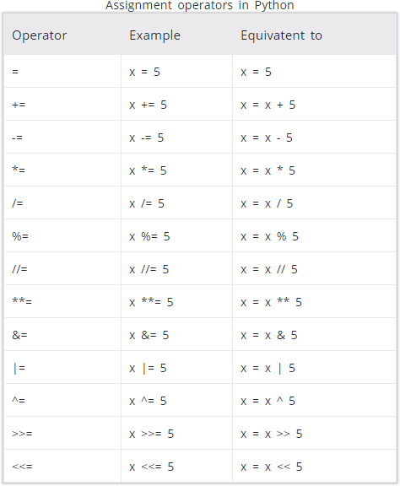

Slide 14
Special operators
identity operator
membership operator

Slide 15
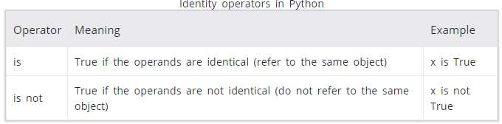
Identity operators
is and is not are the identity operators in Python.
They are used to check if two values (or variables) are located on the same part of the memory.
Two variables that are equal does not imply that they are identical.

Slide 16
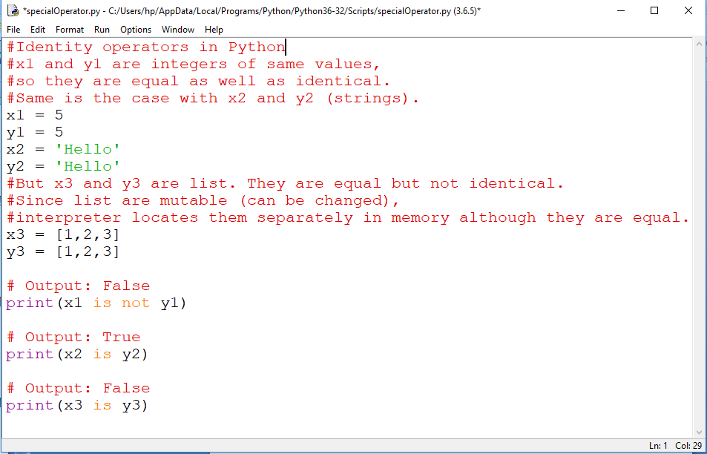


Slide 17
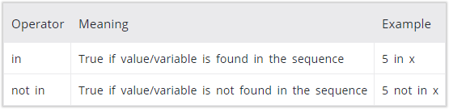
Membership operators
in and not in are the membership operators in Python
They are used to test whether a value or variable is found in a sequence (string, list, tuple, set and dictionary).
In a dictionary we can only test for presence of key, not the value

Slide 18
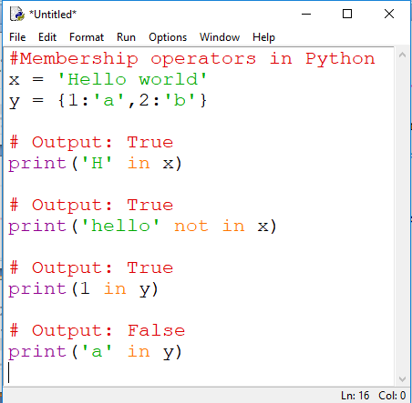


Slide 19
